Slide 1
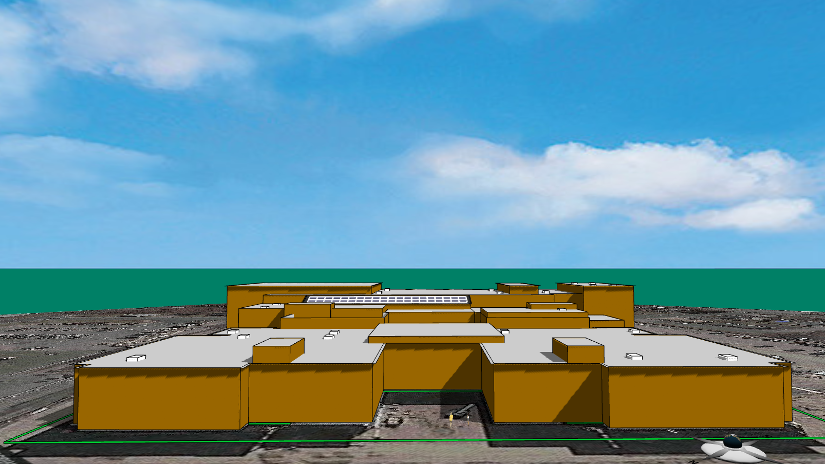
Solarize Your World
Chapter 2: Solarize Your School
Your town is calling for bids to power your school with solar energy. As a solar engineer, you will design cost-effective solutions that turn the school building into a power generator to meet the challenge.

Slide 2
1. Design Specifications
Goal: Generate more than 400,000 kWh of electricity per year with a payback period shorter than a decade.
Project Information
The project’s lifetime is set to be 25 years. Your town has contracted with a utility company to sell the generated electricity at a guaranteed price of 18 cents per kWh for the next 25 years. The cleaning and maintenance cost per solar panel is $2 per year for each solar panel. The rack for mounting the solar panels costs $20 per solar panel. The interest rate on the bank loan to purchase and install the solar panels, racks, and supporting systems is fixed at 2.95% for 25 years. These parameters have been set in your school’s Energy3D model, available in the Virtual Solar Grid (vsg.concord.org).
Constraints
Types of solar panel: Your town has negotiated with three manufacturers, which offered three different types of solar panel as shown in the following table. You must select one and only one of them for your project. The prices listed in the table have factored in the insurance cost, the installation cost, and other costs.
Budget limit: The total upfront cost of the solar panels, racks, and supporting systems must not exceed $800,000.
Installation location: The solar panels must be installed on and within the roofs. Chimneys, vents, and heating and cooling equipment on the roofs must be left open and accessible.
Manufacturer | SunPower | Yingli | Canadian Solar
Model | SPR-X22-370 | YL375D-36b | CS6X-355P-FG
Cost per Panel ($) | $590.00 | $589.00 | $529.00
Power Output (Watt) | 370W | 375W | 355W
Solar Cell Efficiency | 22.7% | 19.29% | 18.18%
Dimension | 1.04m x 1.55m | 0.99m x 1.96m | 0.99m x1.96m

Slide 3
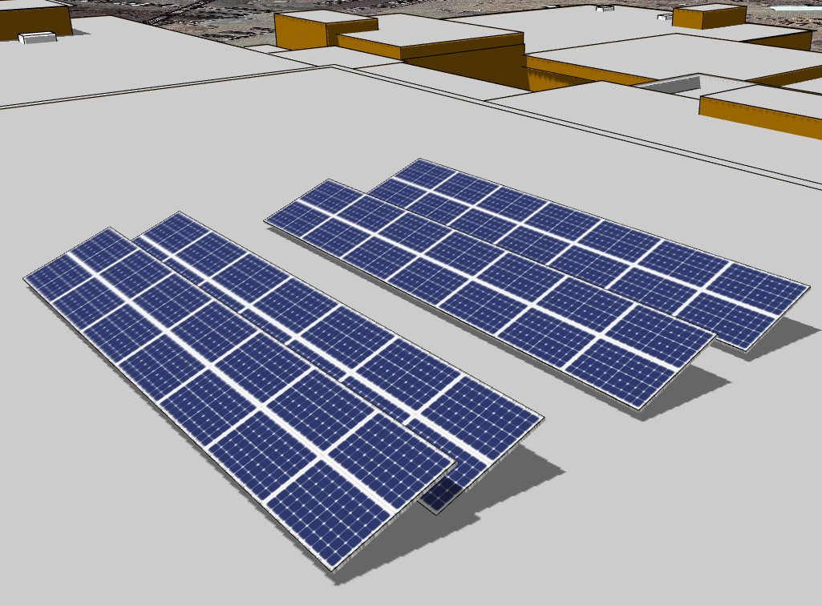
2. Design Variables
During this engineering design activity, you should try changing the following variables to optimize the return on investment (ROI) so that you can achieve the shortest payback period:
The type of solar panel. Different solar panels have different efficiencies, dimensions, and costs. A panel with a higher efficiency will generate more electricity. A larger panel will take up more space. A more expensive panel will result in a longer payback period, but it may retain a higher value beyond the project lifetime.
The location of solar panels. The solar panels should be away from the tall structures on the roof as they may cast shadow on the panels that are too close to them, reducing their output at certain time of the day.
The orientation of solar panel arrays. An optimal orientation will allow the solar panel to face the Sun and receive more energy during the day. The orientation includes the azimuth and tilt angle of the solar panel.
The distance between adjacent rows. The distance between adjacent rows of tilted solar panels will affect their output because a row may cast more shadow on its neighbor when they get closer.
Tips: To speed up the analysis (which may be slow if you have lots of solar panels), you can start with a short row of solar panels while searching for optimal orientations and a few short rows while experimenting with the inter-row spacing. After you get a sense about what settings may be optimal and what output may be reachable from a small array, you can then use the insights to create a full-scale field.
✔
×

Slide 4
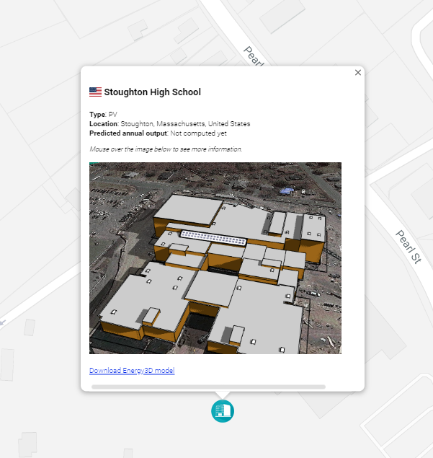
3. Instruction
A. Download the Energy3D model of your school building
Open the Virtual Solar Grid (vsg.concord.org) in a browser.
Type “Stoughton High School, MA” in the search field.
Click on the marker.
Click the “Download Energy3D model” link in the popup window.
Once downloaded, go to the computer’s Downloads folder and move the file to your working folder.
Open the downloaded file from within Energy3D using File > Open....
B. Add solar panels
Click the button on the toolbar.
Move the mouse over to the roof and click on it. This adds a small array of solar panels.
Drag the points at the edges to enlarge or shrink the array and the point at the center to move it around.
To choose a model for a solar panel, right-click on it and select Change Solar Panel Properties > Model... Pick a model from the list. Note that the selected model must be one of the three required earlier.
To add more solar panel arrays, right-click on an existing rack and select Copy from the popup menu. Then right-click on where you want the center of the new rack to be and select Paste from the popup menu. If a part of the new rack is outside the roof, it will not be added and you will be warned.

Slide 5
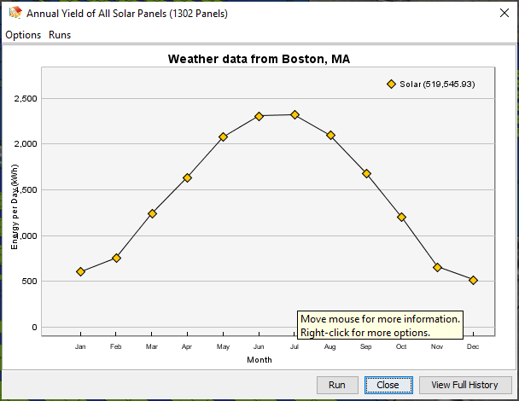
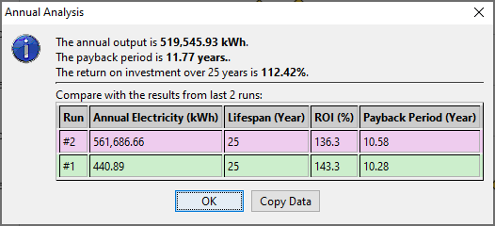
C. Orient the solar panel arrays
To change the azimuth angle of a solar panel array, click to select it and then click on the toolbar in the clockwise direction. To reverse the direction of rotation, hold down the CTRL key on the keyboard while clicking the button.
To change the tilt angle, right-click on it and select “Fixed Tilt Angle…” from the popup menu.
D. Analyze the output of the solar panels
To check the annual electricity output of your solar panels and calculate the return on investment, select Analysis > Solar Panels > Annual Yield of Solar Panel…
When a graph window pops up, click the Run button at the bottom to start your analysis.
E. Iteratively optimize your design
Review the outputs carefully to check whether your design meets all the criteria and constraints. You won’t be able to get everything right at first try. Try changing the type of solar panels, the layout of the array, and their orientation. Compare the outputs after each change to see whether the results improve. Make decisions for your next change based on the analysis results, not guessing.

Slide 6
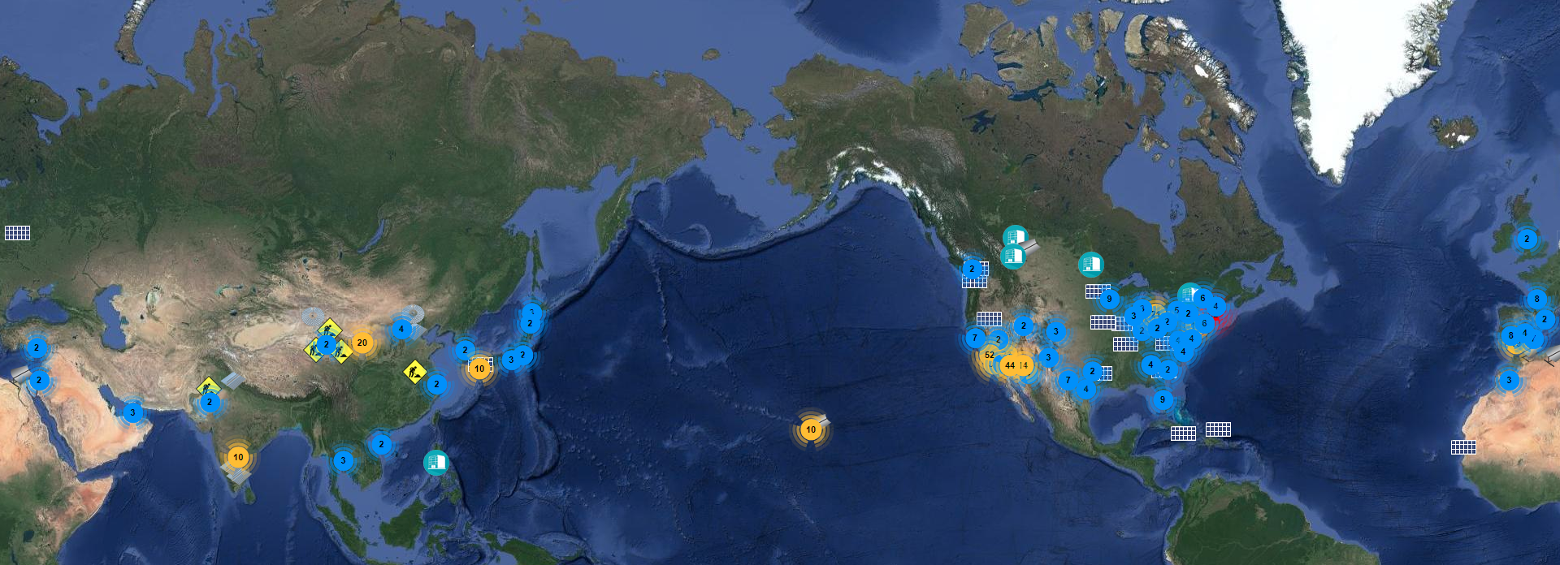
V. Document and Report
At the end of each iteration, complete the report in your Answer Sheet. Select one final design to present to the town and justify your recommendation with the results of your analyses.
VI. Submit your Design to the Virtual Solar Grid (Optional)
Join others around the world to build the global solar grid by submitting your design. To submit, select File > Submit to Virtual Solar Grid...

