Slide 1
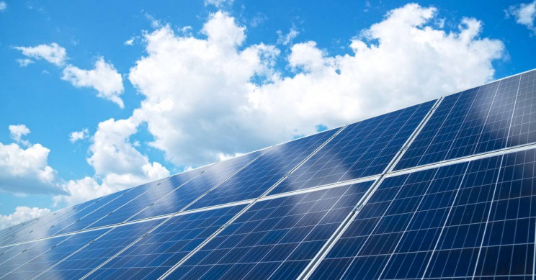
Solarize Your World
Chapter 1: Science Concepts
As a renewable source, solar energy is important to the sustainability of our society. The solar energy that hits the Earth's surface in just one hour is enough to power the whole world for an entire year. Yet, only less than 2% of the total electricity generated in the United States in 2018 came from the Sun. To protect our environment, we must increase the use of solar energy. In this project, you will take on the role of a solar energy engineer to develop creative solar solutions for your own world.
To get started, you must first learn basic science concepts that are essential to designing effective solar solutions. You will explore how the Sun moves in the sky as the Earth orbits the Sun and rotates around its own axis, how its path changes from season to season, and how the length of the day varies. You will also investigate how the Sun’s position relative to a surface affects the intensity of sunlight that shines on it, how the intensity depends on the time of the day and the weather, and how solar energy reaches an object on the ground through different pathways. At the end of this chapter, you will use the knowledge that you have learned to solve a practical problem.

Slide 2
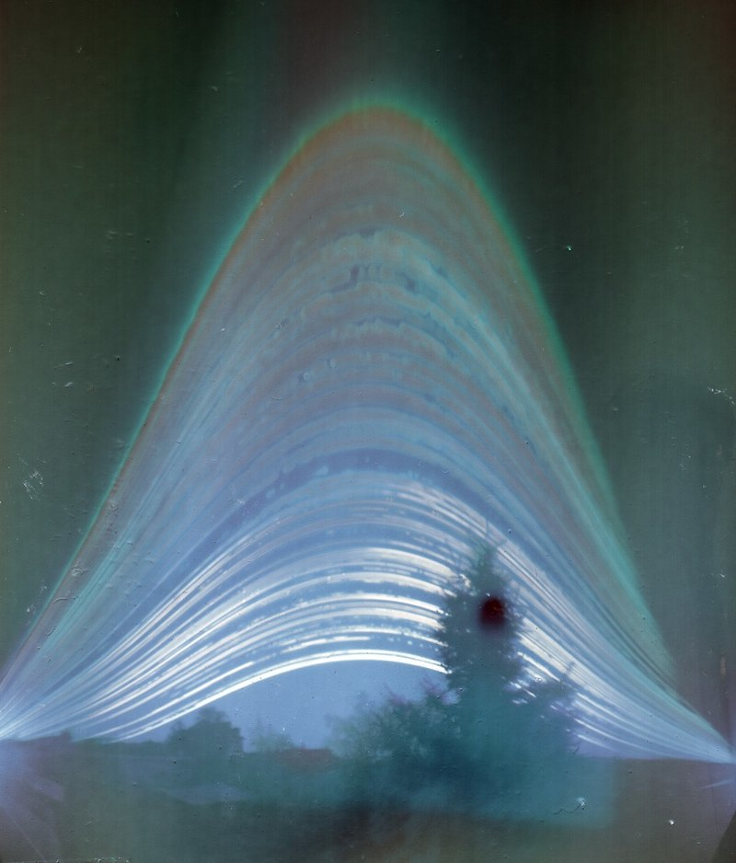
1. The Sun Path
1.1 Daily Change of Solar Angles
The Sun moves across the sky from sunrise to sunset (Figure 1). The Sun’s path refers to its trajectory that an observer on the Earth perceives. The direction of the Sun relative to a horizontal surface on the Earth at a given time dictates how much solar energy it receives at that moment (which partly drives the temperature variations throughout a day). The direction can be represented by three angles: zenith angle, elevation angle, and azimuth angle. The zenith angle is the angle between sunlight and the vertical direction. The elevation angle is the angle between sunlight and the horizontal direction (complementary to the zenith angle). And the azimuth angle is the angle between sunlight and the north direction. These angles change all the time as the Sun moves along its path in a day.
Energy3D activity: To observe these changes, open Tutorials > Solar Science Basics > Sun Path in Energy3D and follow the instruction in Sheet 1.
Figure 1. Solargraphy captures the Sun path across the sky throughout the year of 2014 in Budapest.
Credit: Elekes Andor

Slide 3
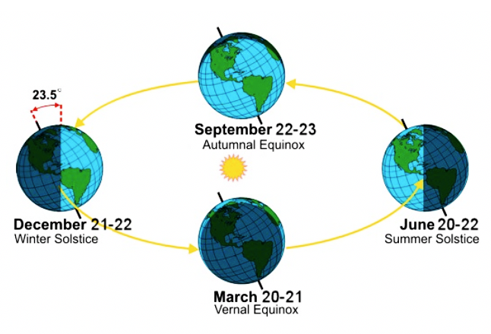
1.2 Seasonal Change of Solar Angles
The seasonal change on the Earth occurs due to the tilt of its axis of rotation relative to the ecliptic—the plane of its orbit around the Sun. There are four special points on the Earth’s orbit around the Sun, which correspond to four special days of the year—the equinoxes and solstices, as shown in Figure 2.
Energy3D activity: To observe the seasonal changes of the Sun’s direction, open Tutorials > Solar Science Basics > Sun Path in Energy3D and follow the instruction in Sheet 2.
Figure 2. Solstices and equinoxes. Credit: National Weather Service

Slide 4
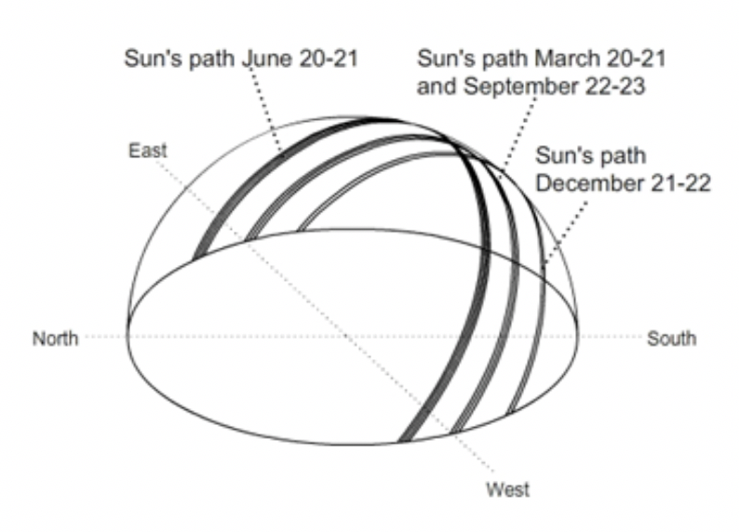
1.3 Seasonal Changes of Daytime
The total solar energy that strikes a surface on the Earth in a given day depends on the length of the day—the lapse of time from sunrise to sunset known as daytime. As the Sun path changes from season to season, the daytime varies throughout the year (Figure 3).
Figure 3. The daytime varies from season to season as the Sun path changes (viewed from the northern hemisphere).
Energy3D activity: To observe the seasonal changes of daytime, open Tutorials > Solar Science Basics > Sun Path in Energy3D and follow the instruction in Sheet 3.

Slide 5
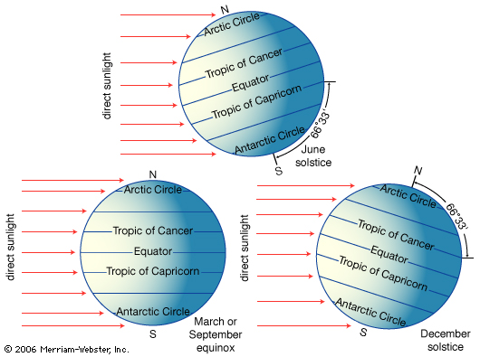
1.4 The Sun Path in Different Parts of the World
As the Earth spins, different parts of the world may receive different amounts of solar energy on the same day. During the March and September equinoxes (Figure 4). the Sun is directly overhead at the Equator and the daytime is the same everywhere on the Earth (the lengths of day and night are also the same—12 hours each). But during the June solstice, the Sun is above the Tropic of Cancer (23.5° north to the Equator). It never sets at the North Pole and never rises at the South Pole. On the other hand, during the December solstice, the Sun is above the Tropic of Capricorn (23.5° south to the Equator). It never rises at the North Pole and never sets at the South Pole.
Figure 4. The Sun’s direction relative to the Equator, the Tropic of Cancer, and the Tropic of Capricorn in different seasons.
Credit: Merriam-Webster, Inc.
To observe the Sun path in different parts of the world, open Tutorials > Solar Science Basics > Sun Path in Energy3D and follow the instruction in Sheet 4.

Slide 6
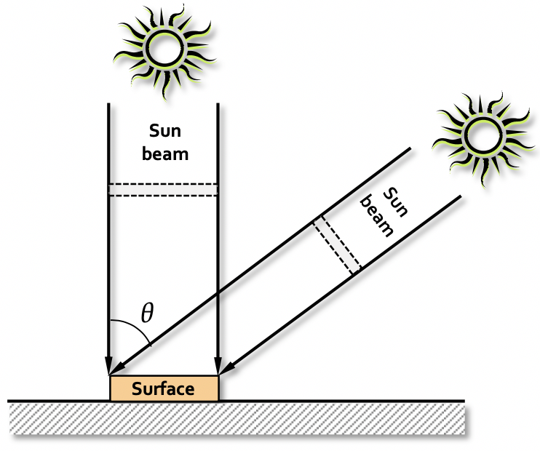
2. The Projection Effect
Solar radiation on a surface is the strongest when it faces the Sun directly. As the angle between the sunlight beam and the surface normal (the direction perpendicular to the surface) increases, the intensity of solar radiation on the surface decreases. Mathematically, this is governed by the following formula:
where E_{max} is the maximum solar energy that hits the surface when it faces the Sun directly and θ is the angle between the sunlight beam and the surface normal. Figure 5 illustrates this effect.
Figure 5. The projection effect on a horizontal surface. The sizes of the dashed areas represent the amounts of solar radiation that the surface receives at the two angles.
To investigate the projection effect, open Tutorials > Solar Science Basics > Projection Effect in Energy3D and follow the instruction in Sheets 1 and 2.

Slide 7
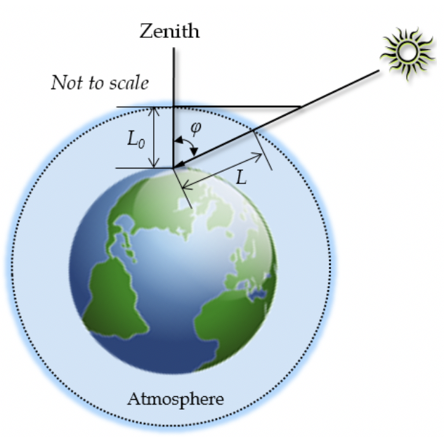
3. The Effect of Air Mass
When the Sun is at a lower angle, sunlight must travel a longer distance in the atmosphere before it reaches the ground (Figure 7). While the light shines through the atmosphere, it can be absorbed or scattered by air molecules, causing its intensity to diminish on the way. This is why the Sun appears to be weaker at dawn and dusk. In solar engineering, the loss of solar radiation to atmospheric absorption or scattering is known as air mass.
Figure 6. The attenuation of solar radiation in the atmosphere depends on the travel length.
To study the effect of air mass, open Tutorials > Solar Science Basics > Air Mass in Energy3D and follow the instruction in Sheet 1.

Slide 8
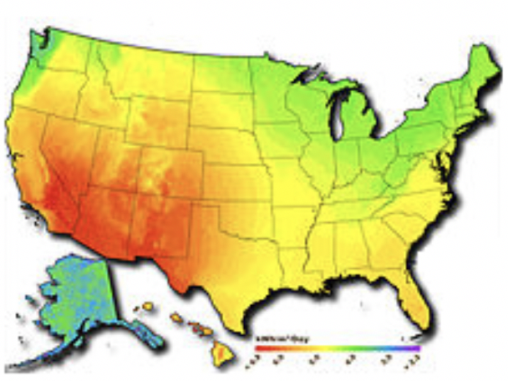
4. The Effect of Weather
Insolation is largely determined by the latitude, but it is also affected significantly by the weather pattern, especially the sky clearness (which is approximately represented in Energy3D as the sunshine hours). Figure 7 shows an solar radiation intensity map of the United States, on which red color represents high intensity and blue color represents low intensity.
Figure 7. A distribution of yearly insolation in the United States. Credit: Wikipedia.
To examine the weather effect on solar radiation in different locations, open Tutorials > Solar Science Basics > Weather Effect in Energy3D and follow the instruction in Sheet 1.

Slide 9
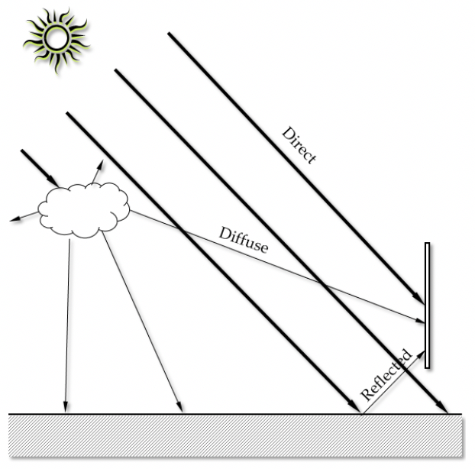
5. Solar Radiation Pathways
A surface on the Earth receives solar radiation through three different pathways: direct, diffuse, and reflected. The direct radiation is the solar radiation that travels to the surface from the Sun without being absorbed or scattered. The diffuse radiation is the portion of solar radiation scattered or re-emitted by the atmosphere in all directions, which can be as little as 15% when the Sun is high in the sky or as much as 40% when the Sun is low. The reflected radiation is the radiation bounced off non-atmospheric objects such as the ground or the objects on it. The ratio of the reflected radiation from a surface to the incident solar radiation is known as albedo. The albedo of land is in the range between 0.1 and 0.4. The albedo of green grass is about 0.25 whereas that of fresh snow can be as high as 0.9. Figure 8 illustrates these three different pathways with a vertical surface as an example.
To investigate these pathways, open Tutorials > Solar Science Basics > Solar Radiation Pathways in Energy3D and follow the instruction in Sheet 1 and Sheet 2.
Figure 8: Direct, diffuse, and reflected radiation onto a vertical surface.

Slide 10
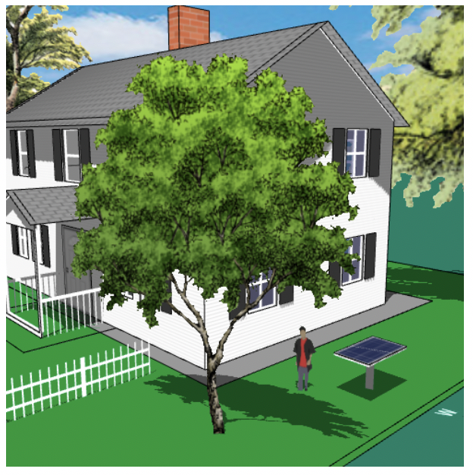
6. Test Your Knowledge
Now you have an opportunity to apply what you have learned to solve a real-world problem as follows.
Judd just bought a solar panel. Now he has to figure out where to install it around his house and how to orient it so that it can generate the most electricity for the whole year.
To help him make decision, open Tutorials > Solar Science Basics > Optimize It in Energy3D to work on a 3D model of his house and the solar panel. Follow the instruction in Sheet 1 to search for a “sweet spot” for the solar panel.
Figure 9. Find a position and orientation for a solar panel around a house that generates most electricity throughout a year.

