Slide 1
Energy-Plus Home Design
Mansfield High School
The Concord Consortium
May, 2016

Slide 2
What is an Energy-Plus Home?
Energy production > Energy consumption
Net energy = Heater + AC – Solar Panels < 0 kWh
Your job
Complete three designs using Energy3D

Slide 3
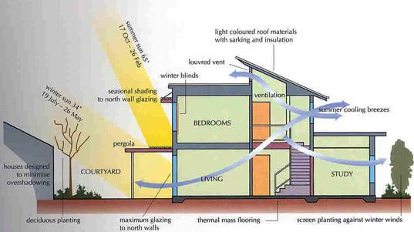
What’s In It for Me?
Learning and Innovation Skills
Knowledge in green building science
Creativity and Innovation
Critical thinking and problem solving
Communication and collaboration
Be environmentally conscious
Be a smart homebuyer and homeowner
Become a building science professional

Slide 4
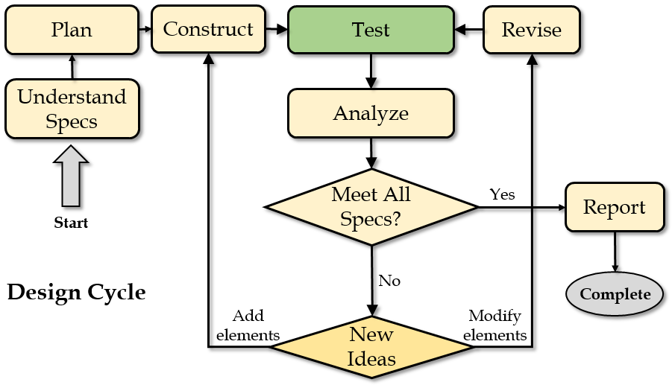
An Engineering Design Cycle
Notes:
Before you do anything, you should read this document carefully to make sure that you fully understand the design specs, which specify what the client wants. Then you should think about what you will do to meet those specs. You can discuss with your classmates about ideas. After you have some basic ideas, you can start with constructing a house in Energy3D that you think may appeal to the client. Once you are happy with it, you can analyze its energy performance. Energy3D can automatically calculate the annual energy usage for heating and cooling. Based on your analysis of the results, you will decide how to revise your design to improve the energy efficiency of the house. Meanwhile, your design must meet all the other specs such as style, size, and material cost, as described below.

Slide 5
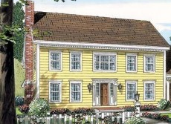
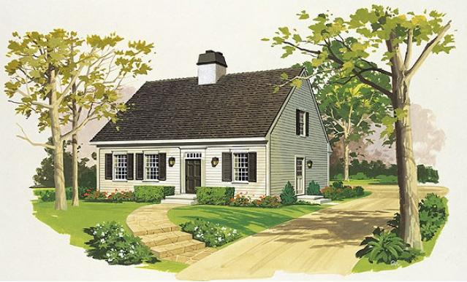
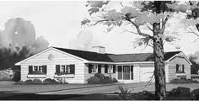
Design Specifications: Styles, Budget, Area, & Height
Colonial (2-story) | Cape Cod (1.5-story) | Ranch (1-story)
$200,000 | $200,000 | $200,000
120 – 160 m² | 100 – 150 m² | 150 – 200 m²
8 – 10 m | 7 – 9 m | 4 – 6 m

Slide 6
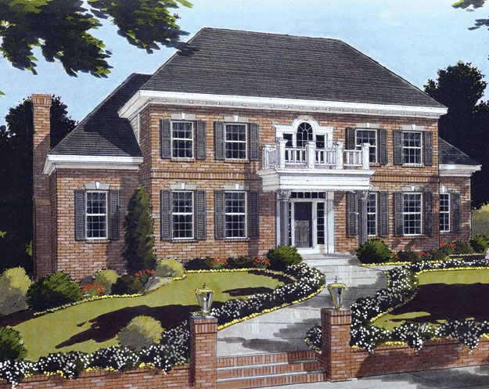
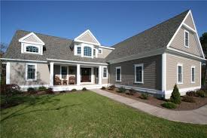
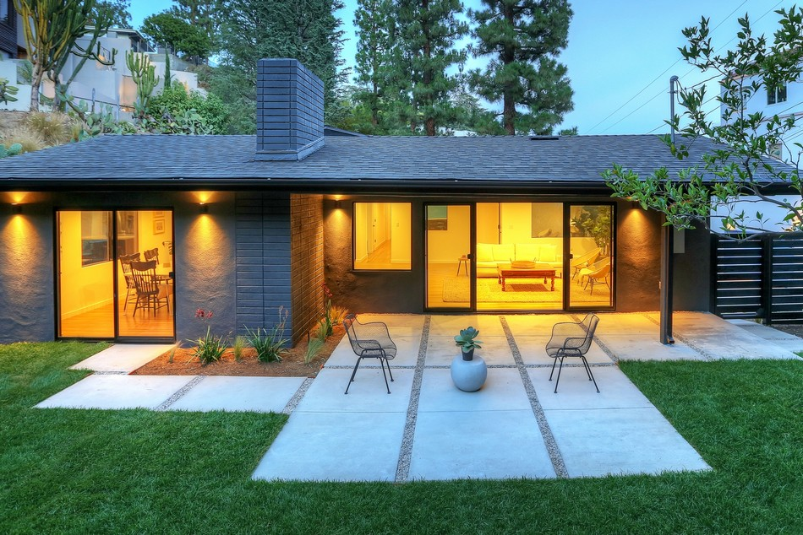
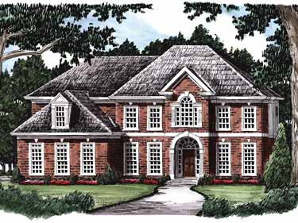
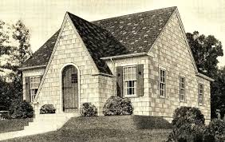
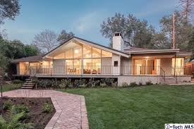
Style Variations
Colonial
Cape Cod
Ranch

Slide 7
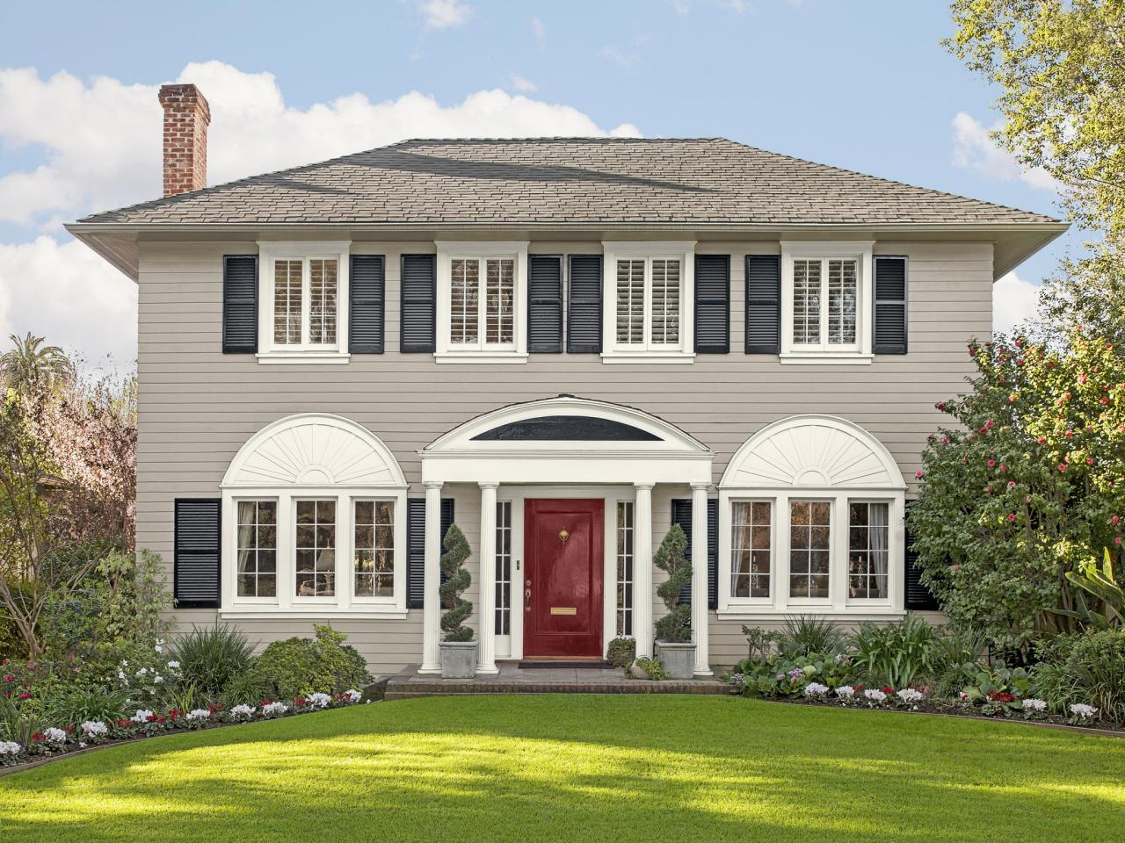
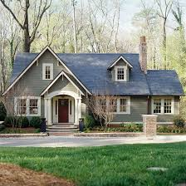
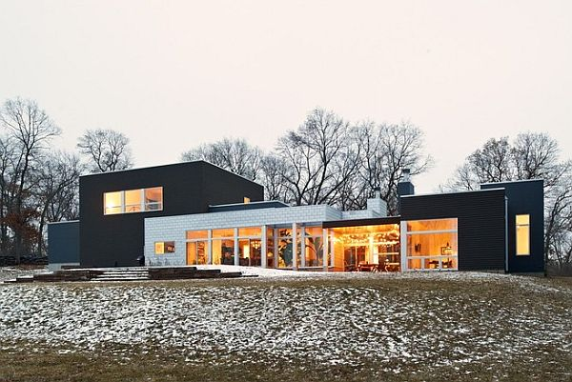
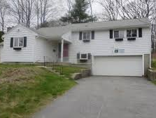
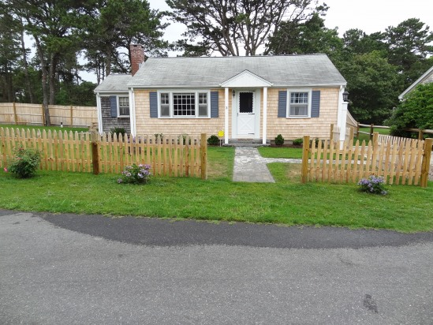
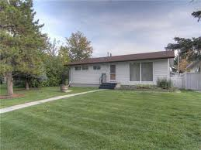
Design Specifications: Curb Appeal
Do I want to live in this home?

Slide 8
Design Specifications: Details
Styles
Budget
Area
Height
Greater Boston
Room temperature: 20°C
Curb appeal
Land parcel: 20m x 20m
Window/Area Ratio:
0.05 – 0.15
Tree trunks:
2m away from walls
Roof overhang
< 50cm
Do NOT add
entry porches, dormers, chimneys, garages, or driveways;
rooms, floors, stairs.

Slide 9
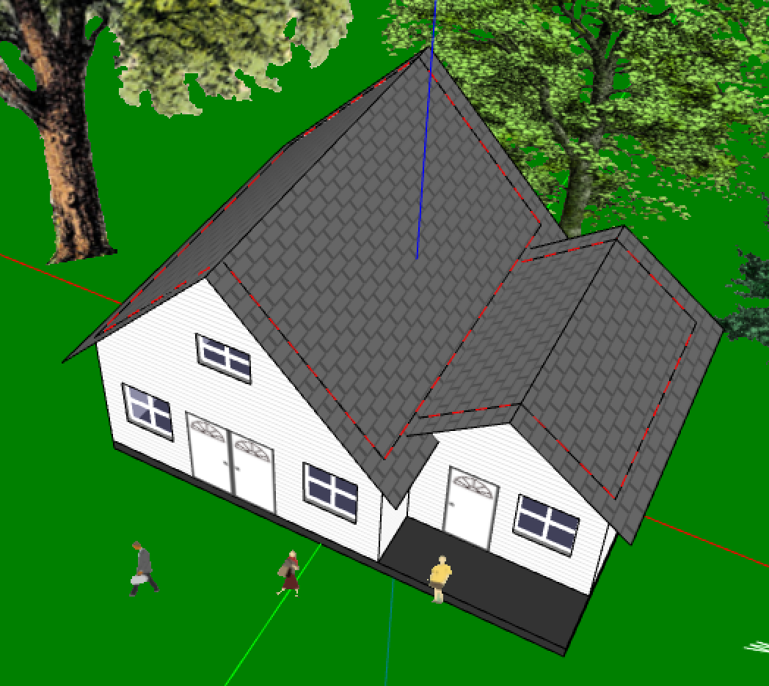
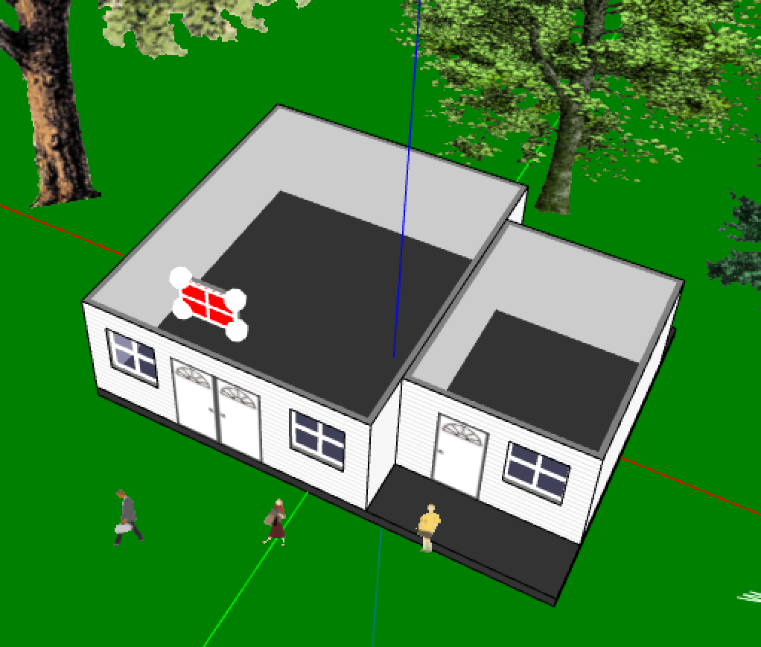
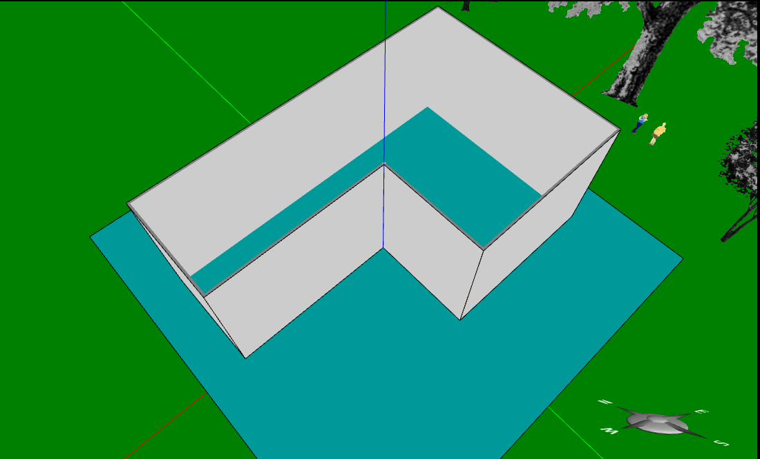
Energy Analysis in Energy3D
→ Inaccurate energy analysis results
→ Build a single enclosure to get accurate energy analysis results

Slide 10
Design Journal
1. Design rationale
Describe your design ideas and explain why you think they are good ideas.
2. Design requirement checklist
Architectural style?
Area, height, window/floor ratio
……
…
3. Analyze the energy efficiency of your design
Version X
Net energy usage
Describe the changes
Why they worked or not
Take notes as you go
4. Explain how you improve energy efficiency of the house
Why you succeed or fail?
Key design features

Slide 11
Work Process
Individual work
(3 designs per student)
Peer review and selection
Presentations
(1 per group)

Slide 12
Notes
USB drive
Write you full name on the tag
Keep it plugged in at all time
Properly eject it at the end
Leave the USB drive to Jie
Energy3D
Open, close, and reopen Energy3D to install updates
Report bugs
Designs
Work with the models provided in the USB
Save changes frequently
Do NOT change file names or folder names
Feel free to ask for help

